Slide 1

CMPG 213 GROUP 11 Analysis Document

Slide 2
Group 11 members
Christiaan Visagie, 37332287
Innocent Ndelema, 35981326
Leon Mostert, 20805330
Pearl Makhafola, 31453600

Slide 3
Table of contents
Project description and scope
Use-case glossary & use-case model diagram
Date model
Process models

Slide 4
1. Project Description and Scope
UIS Analytical Services is a SANAS accredited, ISO/IEC 17025 compliant testing laboratory in South Africa. The laboratory performs analytical tests on a wide variety of sample types and matrices such as soils, minerals, ores (base, ferrous and Platinum Group Metals (PGMs)), metals and coal/ash. Clients that make use of the laboratory’s analytical services consist of mines, metallurgical plants, power stations and mineral export services, from which it is typically geologists, process engineers and export coordinators that interact with the staff at the laboratory.
Analytical samples are submitted to the laboratory by the clients. The samples are logged as part of a work request by assigning the desired analysis and designating a responsible person for the analysis. After the work request is completed, it is invoiced. Once payment from clients have been received, the payment is allocated to the respective invoice.
The objective of this project is to provide UIS Analytical Services with an automated system (LIMS) to help with daily business processes and functions, as well as provide valuable information through extensive reporting to support business decisions. The system will also have database backup functionality, provide/deny access by means of usernames and passwords, and provide elevated functionality to administrator users. Before implementation of the new system, historic data on the current system need to be transferred to the new system. The system will be developed and implemented using the FAST methodology. The scope of the system will include the following functionality:

Slide 5
1. Project Description and Scope (Continued)
The system must be able to perform the following functional requirements:
Maintain employees
Maintain clients
Maintain work requests
Generate invoices
Receive payments
Extensive reporting, including financial statements, outstanding invoices, history of payments per period, and work in progress.
Backup data

Slide 6
1. Project Description and Scope (Continued)
Maintain employees
New employees must be added to the system, and employees that resign must be removed from the system. The system must be able to change the details of current employees.
Employees have the following details: an employee number, first name, last name, ID number, contact number, job title, pay rate, and analytical tests that he/she is competent in. Each employee can only have one job title and can be declared competent in multiple analytical tests (it is possible for an employee to be competent in zero tests).
Only the administrator must be able to maintain employees.

Slide 7
1. Project Description and Scope (Continued)
Maintain clients
New clients must be added the system. It must also be possible to remove clients from the system. The system must be able to change the details of existing clients.
Clients have the following details: a client number, company name, billing address, contact number, email address, and a payment term. A client can only have one payment term.
Only the administrator must be able to maintain clients.

Slide 8
1. Project Description and Scope (Continued)
Maintain work requests
Work from clients is added onto the system as work requests. Once on the system, work requests cannot be deleted however, they can be archived instead. Existing work requests must be able to be changed, provided that they have not been invoiced or archived yet.
Work requests have the following details: work request number, date that the work was received, date that the work is due (two week from reception date). Each work request comes from a client. A client can send any number of work requests (this can also be zero). A lab technician is responsible for a work request. A work request can only have one responsible person however, a lab technician can be responsible for any number of work requests (this can also be zero). Analytical tests and their quantities are assigned to each work request. More than one analytical test can be assigned to a work request.
Both lab technicians and the administrator must be able to maintain work requests.

Slide 9
1. Project Description and Scope (Continued)
Generate invoices
The system must be able to generate an invoice from each work request (provided that it has not been archived). Invoices have the following details: invoice number, date invoiced, date payable (payment term days added to the date invoiced), total amount invoiced, and amount paid.
Only one invoice can be generated from a work request. Initially a work request will have no invoice.
Both lab technicians and the administrator must be able to generate invoices.

Slide 10
1. Project Description and Scope (Continued)
Receive payments
The system must be able to receive payments towards invoices. Payments have the following details: Receipt number, date of payment, and payment amount.
More than one payment can be received for each invoice however, a payment can only be allocated towards one invoice.
Both lab technicians and the administrator must be able to receive payments.

Slide 11
1. Project Description and Scope (Continued)
Extensive reporting
The system must be able to provide extensive reporting, including generating financial statements, displaying outstanding invoices, displaying payments per period, and displaying work in progress.
Both lab technicians and the administrator must be able to request reports.

Slide 12
1. Project Description and Scope (Continued)
The system must satisfy the following non-functional requirements:
Provide secure access control to the system by use of unique usernames and passwords.
The database will be able to hold data for approximately 1500 work requests, 160 clients and 240 staff members.
Queries on the database should not take longer than 5 seconds.
The system should be able to provide different levels of access for general users and administrators, where the former has limited access and the latter full access.
Extensive help functionality will be available.

Slide 13
2. Use-case glossary
Use-Case Name | Use-Case Description | Participating Actors and Roles
Log into system | Event where a user gets access to the system by providing a username and password. | Administrator Lab Technician
Maintain Staff | The event where a new Staff member will be added to the system, the details of an existing Staff member is changed, or an existing Staff member is removed from the system. | Administrator
Maintain Clients | The event where a new Client will be added to the system, the details of an existing Client is changed, or an existing Client is removed from the system. | Administrator
Maintain Work Requests | The event where a new Work Request will be added to the system, the details of an existing Work Request is changed, or an existing Work Request is archived on the system. | Administrator Lab Technician
Generate invoice | The event where a Work Request is invoiced. | Administrator Lab Technician
Receive payment | The event where payment for an invoice is received from the client. | Administrator Lab Technician
Backup data | The event where the database is backed up (copied) to an external hard drive. | Administrator
Request report | The event where a report is requested from the system and displayed on the screen. A hard copy can also be printed. | Administrator Lab Technician

Slide 14
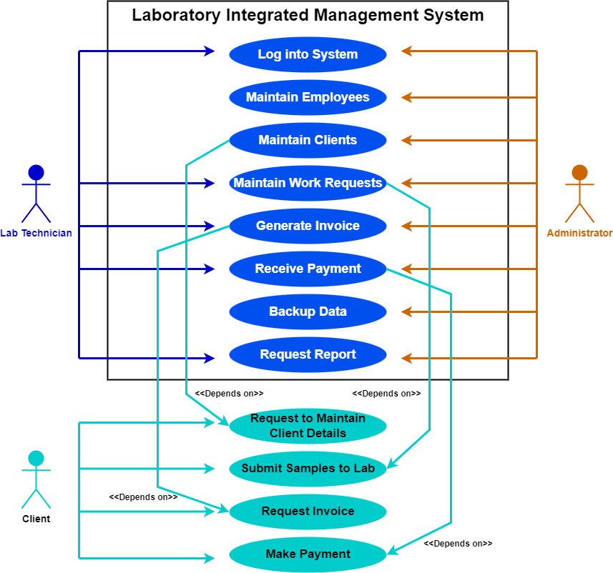
2. Use-Case Model Diagram

Slide 15
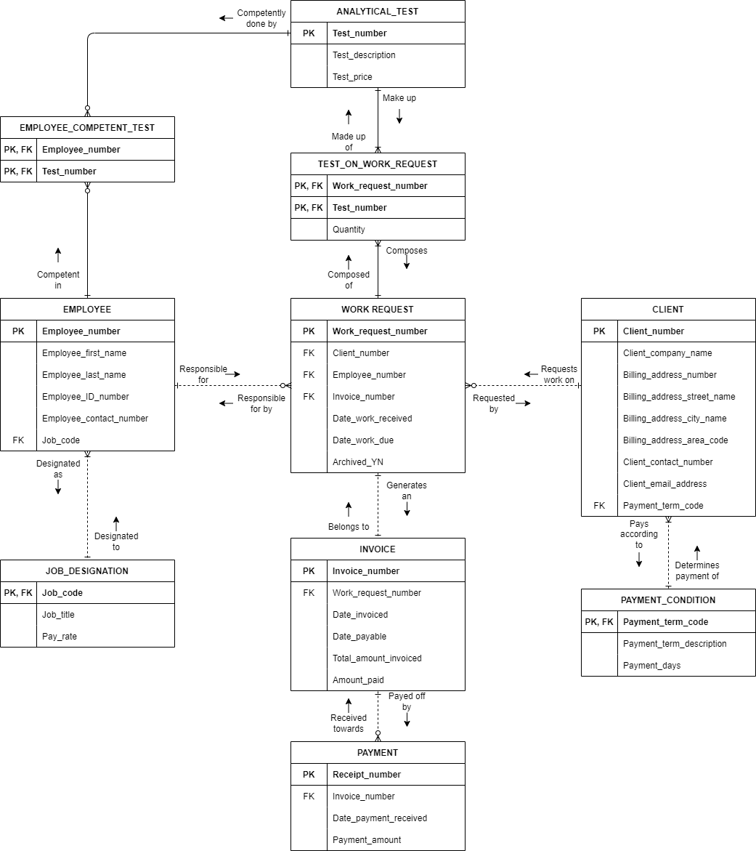
3. Data model

Slide 16
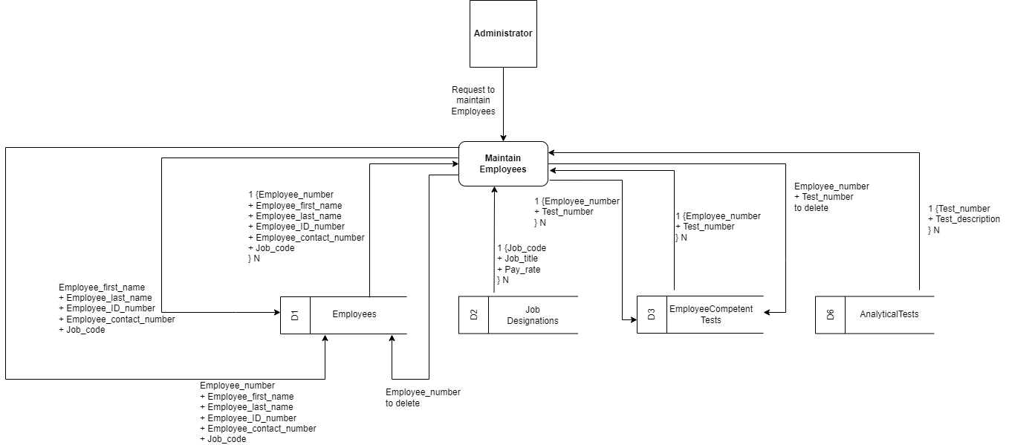
4. Process models

Slide 17
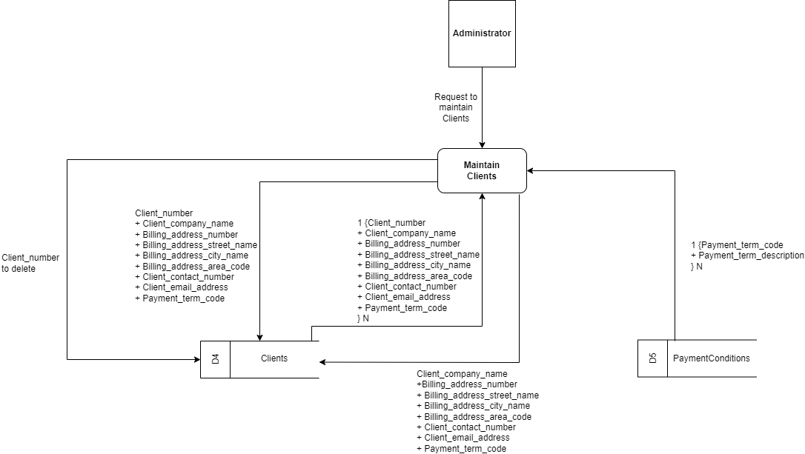
4. Process models (Continued)

Slide 18
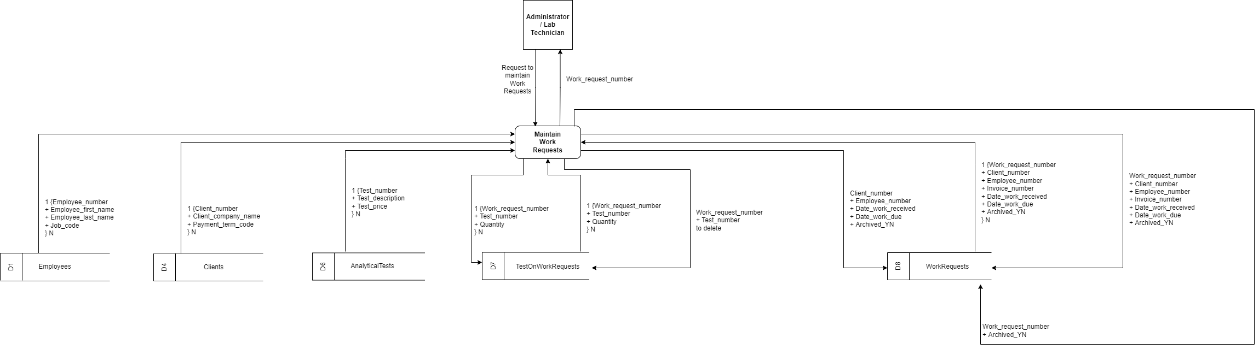
4. Process models (Continued)

Slide 19
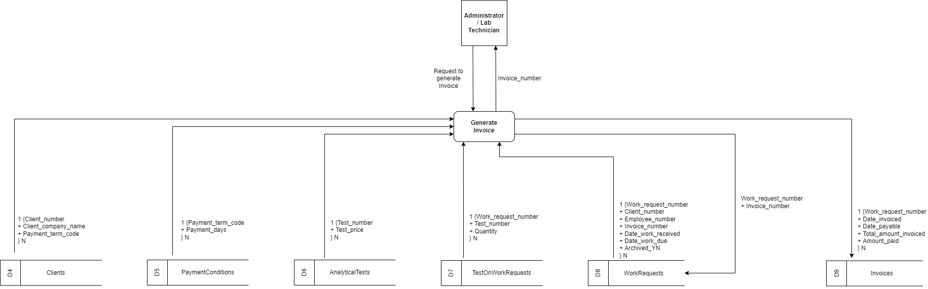
4. Process models (Continued)

Slide 20
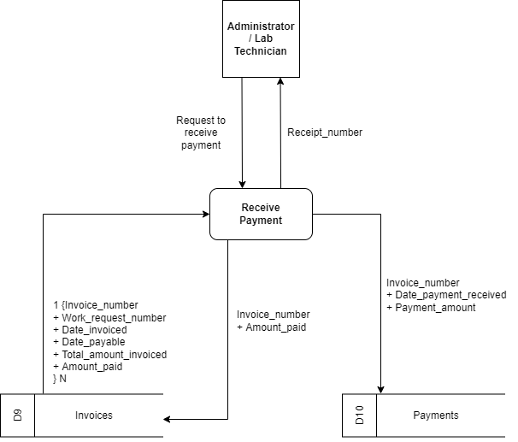
4. Process models (Continued)

Slide 21
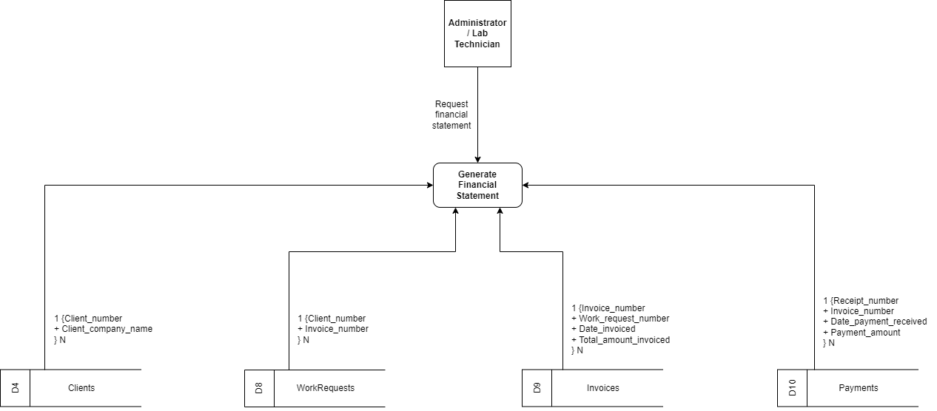
4. Process models (Continued)

Slide 22
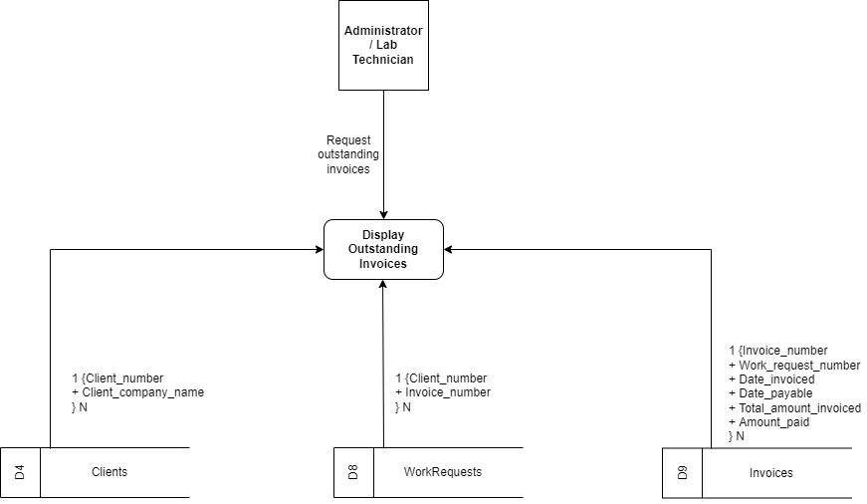
4. Process models (Continued)

Slide 23
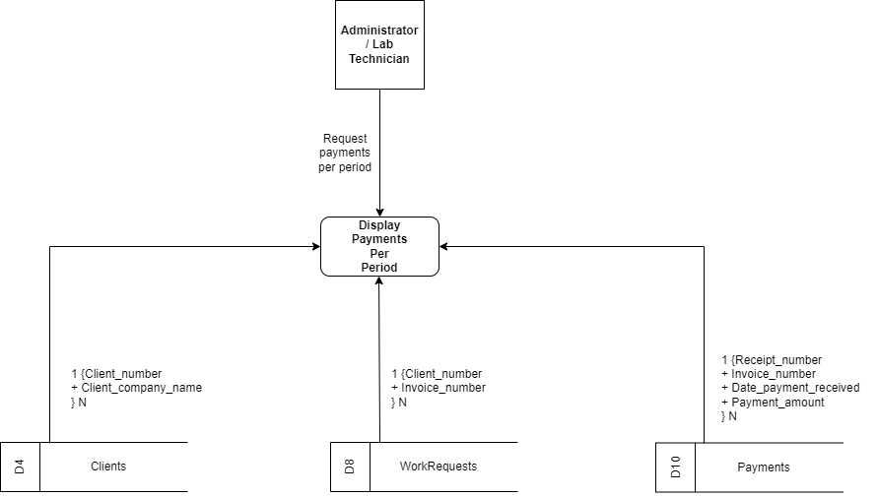
4. Process models (Continued)

Slide 24
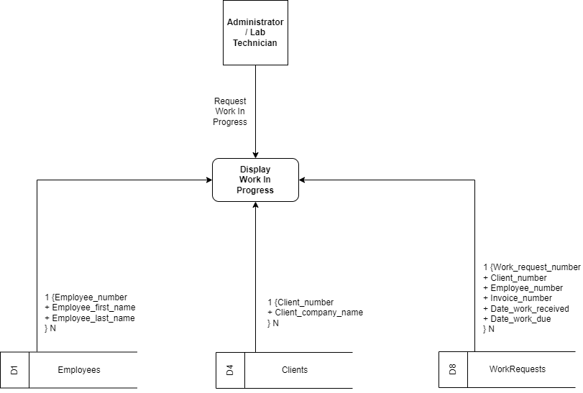
4. Process models (Continued)

